Slide 1




RMF Assistant
Evidence-Grounded Policy and Control
Reasoning for RMF
UMBC DATA 606 Capstone • Jason Miller • April 2026
Policy Docs
Vector DB
Hybrid Retrieval
Chat UI
Notes:
This project is a demo-quality RMF assistant, not a generic chatbot. The core idea is grounded reasoning over policy and control evidence, with citations and disciplined abstention.

Slide 2



Why This Project Exists
1/10
→
→
Document-Heavy Work
Manual Analyst Effort
Need: Auditable Search
RMF teams navigate extensive policy texts and framework controls daily
Connecting policy evidence to controls is slow, repetitive, and error-prone
Reduce search effort while keeping answers traceable and honest
Goal: reduce search effort while keeping answers auditable
Notes:
The motivation is not 'chat with documents.' The real problem is finding relevant policy evidence, connecting it to RMF controls, and avoiding overconfident answers when evidence is weak.

Slide 3
What RMF Is and Why It Matters
2/10
Risk Management Framework (RMF)
Guides security and privacy risk management for information systems.
Depends on mapping controls, policies, and implementation evidence.
Traceability is essential: what requirement, what evidence, what gap?
This project helps the reasoning step — it does not replace assessors.
RMF Control
▼
Policy Evidence
▼
Analyst Decision
Notes:
Keep RMF simple. The audience needs to understand why policy-to-control reasoning matters.

Slide 4
Project Objective and Scope
3/10
What Was Built
Intentionally Out of Scope
Grounded answers with citations
Policy Q&A and coverage reasoning
Retrieval-only or retrieval + OpenRouter
Honest abstention when evidence is weak
No autonomous compliance decisions
No enterprise-scale orchestration
Not replacing human assessors
Notes:
Emphasize what was built and what was intentionally not claimed.

Slide 5

System Architecture Overview
4/10
Prepare
→
Retrieve
→
Generate
→
Present
Source data chunked
and indexed offline
Hybrid retrieval via
BM25 + Qdrant
Optional OpenRouter
after retrieval
Answer-state logic
renders trust signals
Qdrant = external dense retrieval store
Notes:
The important separation is: preparation path, serving path, answer rendering, deployment path. Qdrant should be explicit.

Slide 6
Data and Retrieval Pipeline
5/10
OSCAL +
Synthetic Policies
Chunking
BM25
Index
Embeddings
→ Qdrant
Fused
Retrieval
→
→
→
→
324
12
Hybrid
OSCAL Controls
Synthetic Policies
Dense + BM25 Fusion
Notes:
The committed source data means the demo does not depend on a raw OSCAL clone at presentation time.

Slide 7
Runtime Answer Flow
6/10
User Question
→
Classify & Retrieve
▼
LLM_BACKEND=none
LLM_BACKEND=openrouter
Retrieval-only output.
Cited evidence chunks
without LLM generation.
Grounded generation using
retrieved evidence. Falls back
to retrieval-only if unavailable.
Answer-State Rendering
Notes:
Explain retrieval-only vs retrieval-plus-LLM mode. The LLM is downstream of retrieval.

Slide 8
Trustworthiness and Answer-State Logic
7/10
Strong
Evidence
Limited
Evidence
Conflicting
Evidence
No
Evidence
Retrieval-Only
Fallback
Backend
Error
Citations and retrieved evidence are always shown as the source of truth
Notes:
This is a key differentiator. The UI signals how much trust the user should place in the answer.

Slide 9
Evaluation Approach
8/10
10
10
10
10
Framework
Policy
Policy vs
Control
Out of Scope
Policy
40-Question Golden Set
Reported metrics: Context Precision • Coverage Accuracy • Abstention • Overall Score
Separates runtime behavior from evaluation artifacts: the app serves answers, the eval set scores grounding quality.
Notes:
The eval framing is not only 'did it answer' but 'did it answer with the right evidence and abstain when appropriate.'

Slide 10
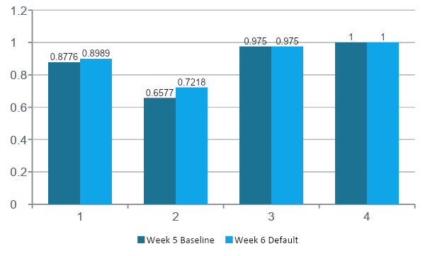
Results and Progress Highlights
9/10
Recommended Config
equal_rerank20
Overall: 0.8989
Coverage: 0.9750
Abstention: 1.0000
Policy-vs-Control gain:
0.7758 → 0.8485
Notes:
Week 6 improved retrieval quality, especially context precision, without degrading coverage accuracy or abstention.

Slide 11


Final System State and Deliverables
10/10
Streamlit UI
Hybrid Retrieval
Policy Q&A, framework lookup, policy-vs-control reasoning
BM25 + Qdrant dense retrieval with fusion and reranking
Trust & Answer States
Deployment Ready
6-state answer classification with inline policy viewing
Containerized app + Qdrant, 45 unit tests passing
Notes:
Frame the project as a technically grounded academic prototype with a cleaner demo and deployment story.

Slide 12
Not included in main slide count
Live Demo
1. What does our access control policy say about least privilege?
2. Summarize the requirement in AC-2.
3. How well do our policies cover PL-2 based on the mini SSP?
Watch for: Citations • Retrieved Evidence • Answer-State Banner • Full-Policy Viewer
Notes:
Start with policy question, then framework query, end with policy-vs-control reasoning. If OpenRouter is unstable, switch to retrieval-only.

